Slide 1
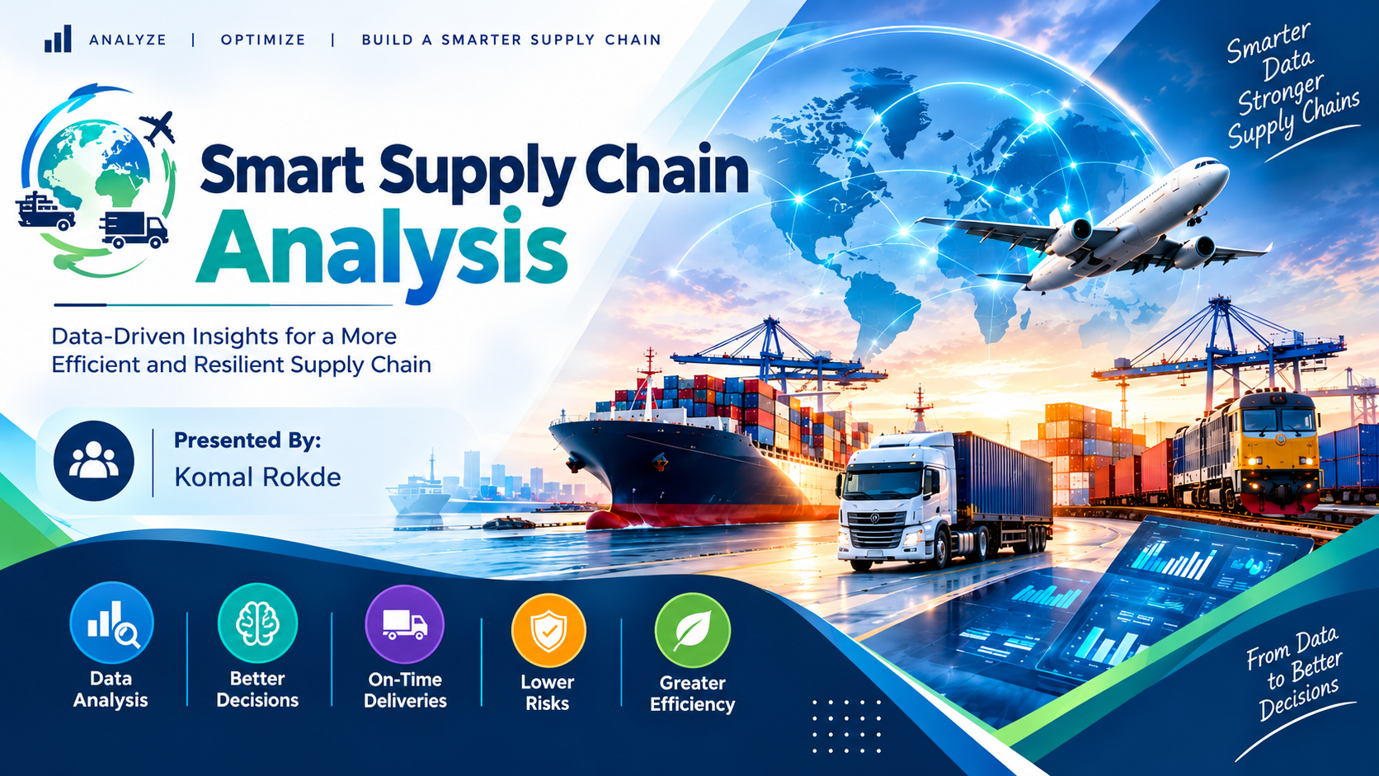

Slide 2
INDEX
SMART SUPPLY CHAIN ANALYTICS
Introduction
Project Objectives
Problem Statement
Tools and Technologies
Project Methodology
Dataset Description
Data Cleaning Using Python
Exploratory Data Analysis
MySQL Database and SQL Analysis
Power BI Dashboard Overview
Executive Overview Dashboard
Supplier Analytics
Route Analytics
Transportation Analytics
External Factors and Delay Analysis
KPI Analysis
Key Insights and Findings
Business Recommendations
Conclusion
Future Scope
02

Slide 3
Introduction
Smart Supply Chain Analytics is a data analysis project designed to analyze shipment performance, delivery delays, transportation costs, supplier performance, and external factors affecting deliveries. The project uses Python for data cleaning and analysis, MySQL for database management and SQL queries, and Power BI for interactive dashboard visualization.
The main purpose is to convert raw shipment data into meaningful insights that help businesses improve delivery performance, control costs, and make better decisions.
.
Business focus
Data foundation
Decision support
Understand shipment volume, delivery delays, supplier performance, transport modes and delivery costs.
60,000 shipment records analyzed across seven connected subject tables.
Power BI views turn operational data into trends, comparisons and risk indicators.
Project outcome
A reusable pipeline: clean → store → query → visualize → communicate.
03

Slide 4
Project objectives
The main objective of project is Turn a multi-table shipment dataset into a clear analytical view.
Analyze 60,000 shipment records.
Measure total shipments, delayed shipments, and delay rate.
Analyze average delay hours and delivery costs.
Evaluate supplier performance and reliability.
Identify high-risk routes and analyze route distances.
Compare transportation modes such as road, rail, air, and sea.
Analyze the relationship between external factors and shipment delays.
Build an interactive Power BI dashboard for decision-making.
01
Prepare reliable data
02
Build a structured store
Clean columns, standardize formats and inspect missing or duplicate records.
Load cleaned tables into MySQL and use SQL for analysis-ready data access.
03
Measure performance
04
Communicate insights
Define shipment, delay, cost, supplier and transport metrics.
Build interactive Power BI pages and plan a Streamlit-facing experience.
04

Slide 5
Problem Statements
Delivery performance
Where are delays happening and how often?
Frequent shipment delays and late deliveries.
Which suppliers have higher shipment volume or delay exposure?
Challenges in evaluating supplier performance.
Supplier reliability
Transport choices
Difficulty identifying high-risk routes.
How do road, sea, air and rail compare on volume, delay and cost?
External conditions
How do weather, traffic and port congestion relate to delays?
05

Slide 6



Tools and Technologies
Python
Used for data cleaning, preprocessing, handling missing values, removing duplicates, and preparing shipment data using Pandas and NumPy.
MySQL
Used to create the database, store cleaned tables, and perform SQL analysis using joins, aggregations, filtering, and queries.
Power BI
Used to create interactive dashboards, KPI cards, charts, slicers, and visual reports for supply chain analysis.
06

Slide 7
Project Methodology
A clear path from raw records to an interactive dashboard.
01
02
03
04
05
Raw Shipment data
Python
MySQL
Power BI
Streamlit
Cleaning, type conversion and quality checks
Structured tables and SQL queries
Model, measures, slicers and visuals
Planned app layer for a Python-based view
Shipment and related operational tables
Result: Insights and Business Recommendations
07

Slide 8
Dataset Description:
Data model: seven subject tables
Separate operational domains make the analysis easier to maintain.
Shipment
Shipment ID • Order ID • Shipment Date • Delivery Date • Delivery Time
Supplier
Supplier ID • Supplier Name • Supplier Rating • Supplier Location
Warehouse
Warehouse ID • Warehouse City
• Warehouse Capacity
Transportation
Transport Mode • Route Distance
• Fuel Cost
External Factors
Weather Condition • Traffic Level
• Port Congestion • Holiday Flag
Business Metrics
Delivery Cost • Delay Hours • Customer Priority
Status
Disruption Status
08

Slide 9
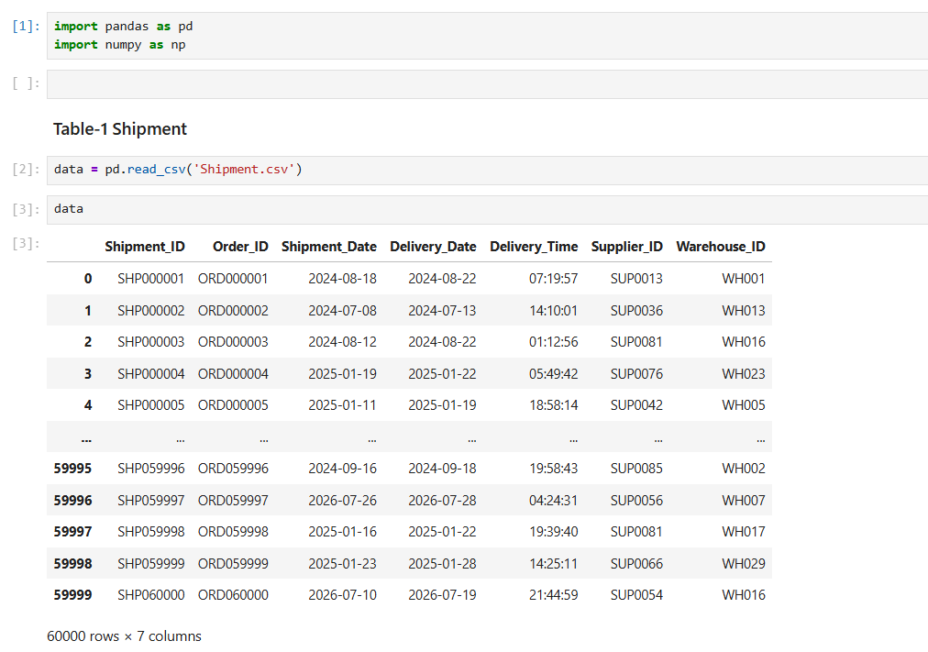
Data preparation in Python
01
Inspect
02
Standardize
03
Validate
04
Export
Save cleaned tables for repeatable loading into MySQL.
Review shape, columns, data types and sample rows.
Trim column names and normalize date / numeric formats.
Check duplicates, missing values and valid ranges.
This code imports the Pandas and NumPy libraries and loads the Shipment CSV file into a Data Frame. The dataset contains 60,000 shipment records with 7 tables, providing information about shipment IDs, order IDs, shipment and delivery dates, delivery times, suppliers, warehouses and status. This data is used for further cleaning, preprocessing, and supply chain analysis.
09

Slide 10
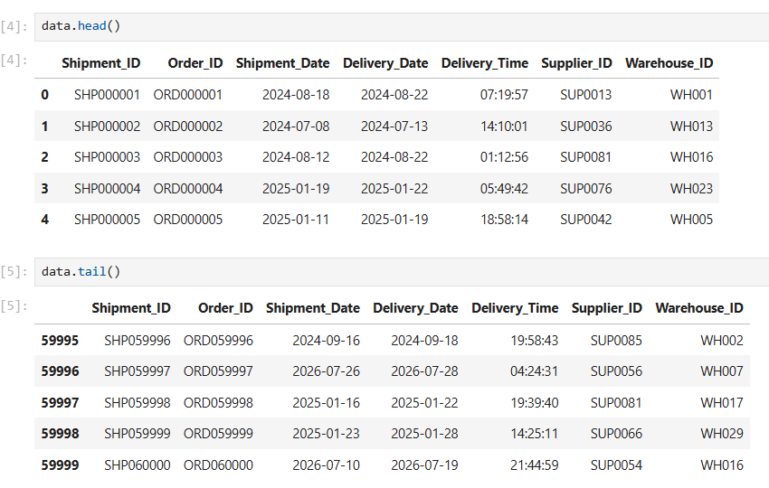
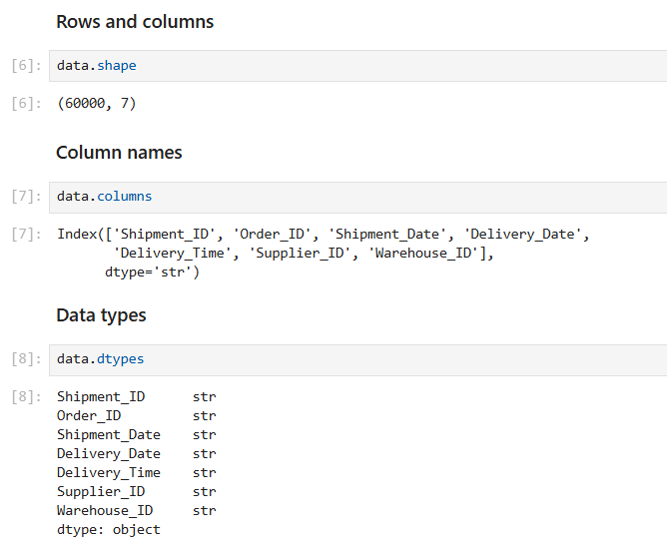
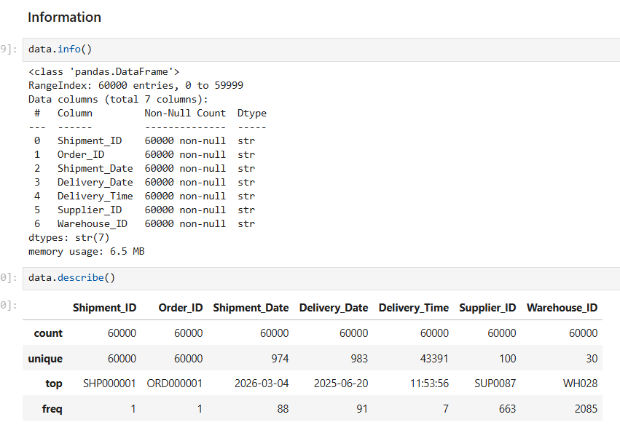
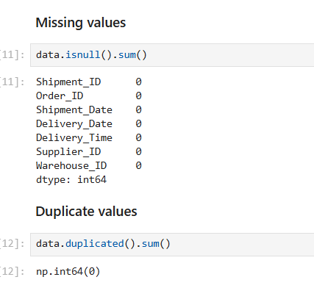
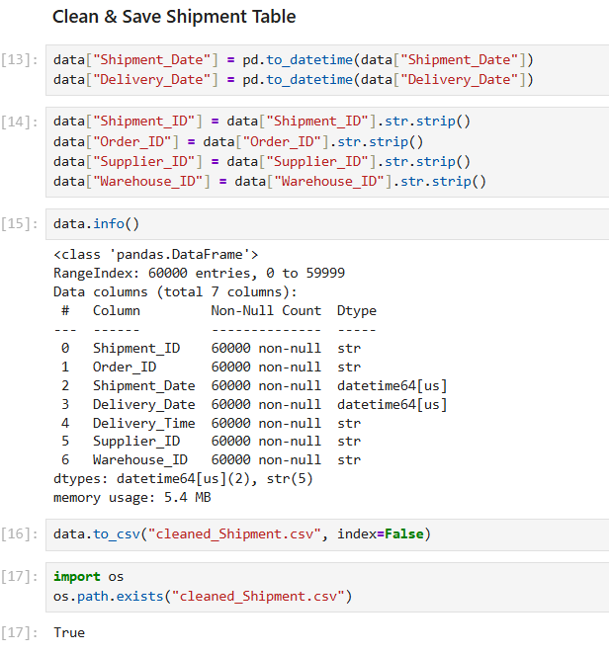
head() & tail() - By using head()and tail() function previewed the dataset and shows first 5 rows and last 5 rows also understand its structure and columns.
Shape() - By using shape() show the total shape of data total rows and columns.
Column - Display all column names
astype() - Display all column data types.
Info() - By using info() function checked data types, non-null values and dataset information.
Describe() - By using describe() function generated statistical summary for numerical columns.
isnull() - By using isnull() function found missing values in each columns.
duplicated() - By using duplicates() checked duplicate records in the dataset.
After performing all data manipulation methods than save cleaned data tables for EDA Analysis.

Slide 11
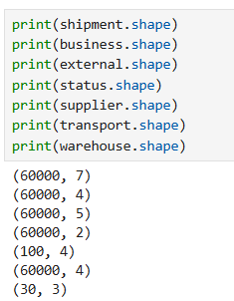
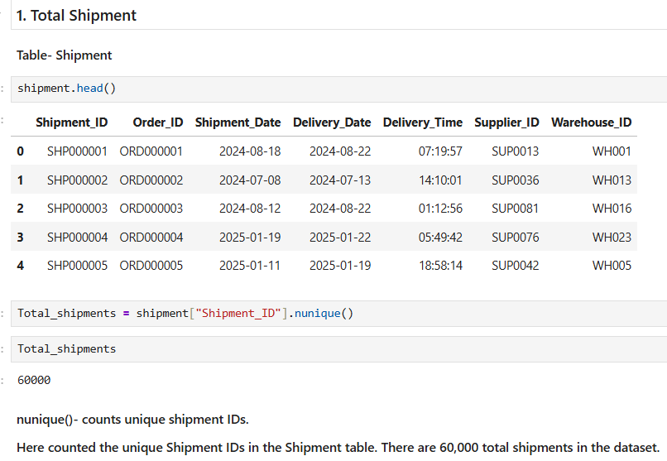
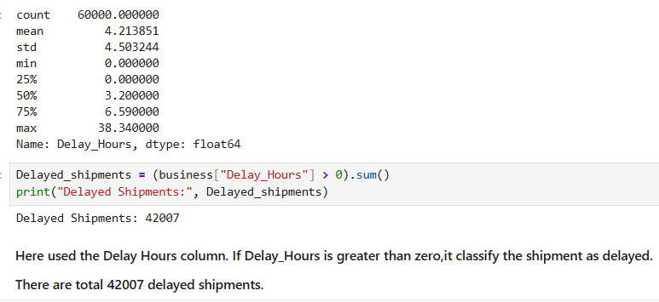
Exploratory Data Analysis
Dataset Overview
Total Rows : 60000
Total Tables: 07
Total number of shipment records: 60000
Total columns in 7 tables: 29
By using Unique() Function Checked total shipment record .
For checking Delay shipments record used business metrics table delay hours column and the total delay shipment is 42007.

Slide 12
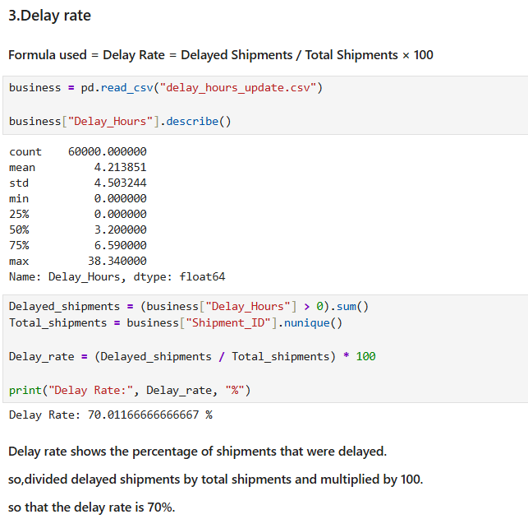
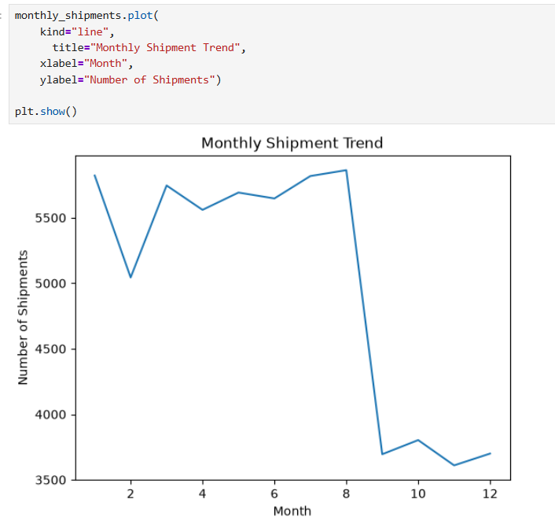
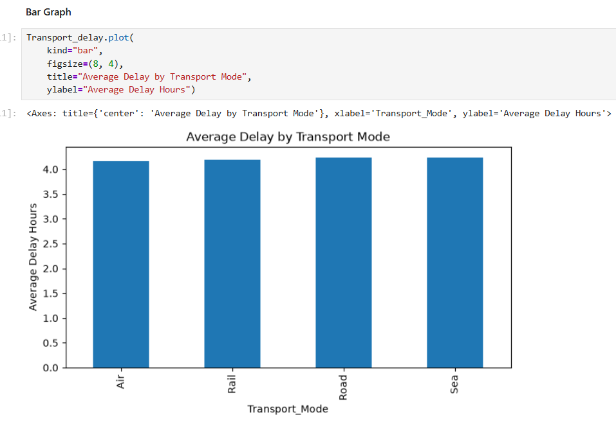
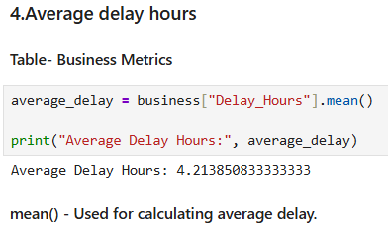
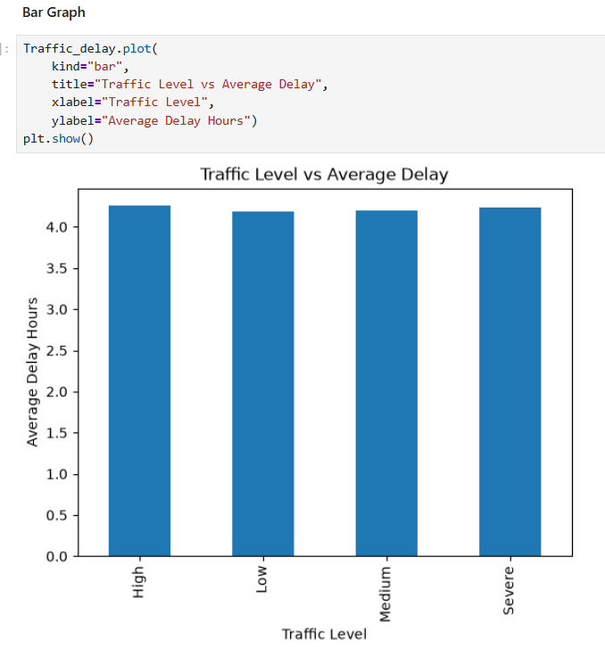
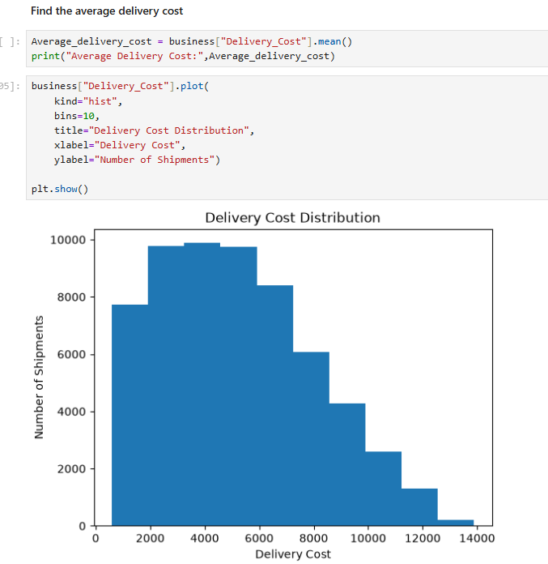
Delay rate shows the percentage of shipments that were delayed. so divided delayed shipments by total shipments and multiplied by 100. so that the delay rate is 70%.
This line plot shows how the number of shipments changes month by month(Shipment Trend by month). Shipment volume was relatively high from January to August, with some fluctuations. There was a significant drop in shipments in September. From September to December, the number of shipments remained lower and relatively stable. This helps to understand the shipments volume trend over time.
grouped the shipments by Transport Mode and calculated the average Delay Hours for each transport mode.
Transport Mode
Air 4.162074 , Rail 4.195871
Road 4.230032 , Sea 4.239343
By using mean() function calculate average Delay hours and average delay hours is 4.21
There are 4 level of traffic in the data set that is High, Low, Medium and Severe
The X-axis shows delivery cost ranges and the Y-axis shows the number of shipments in each range.
From the graph, I can see that most shipments have delivery costs between approximately 2,000rs and 6,000rs.

Slide 13
MySQL: structured storage and SQL
SQL(Structured Query Language) supports reusable checks and aggregations before visualization.
Store
Query
Validate
Load cleaned data into separate, named tables.
Use filters, joins, grouping and aggregates for analysis.
Compare row counts and key totals after loading.
Create Database smart_supply_chain;
SELECT COUNT(DISTINCT Shipment_ID) AS total_shipments
FROM shipment;
Output - 60000
13

Slide 14
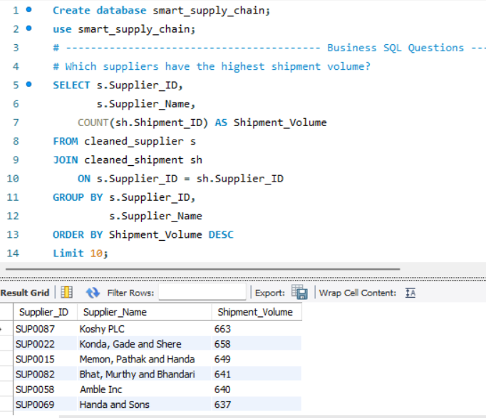
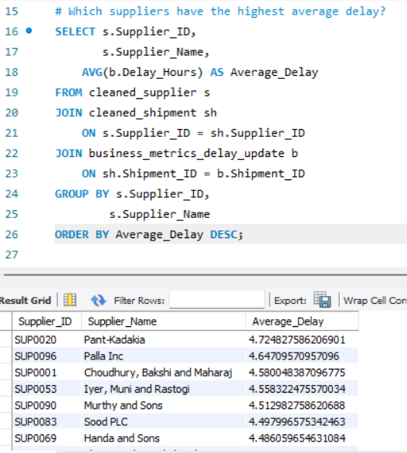
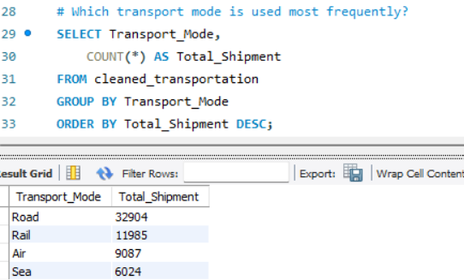
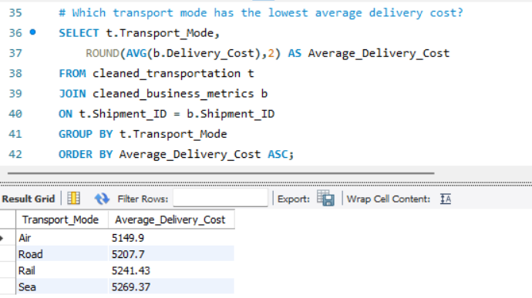
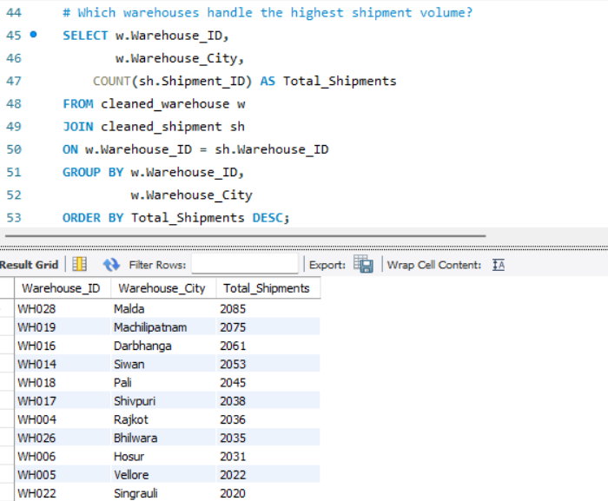
This SQL query identifies the top 10 suppliers with the highest shipment volume. It uses JOIN to combine supplier and shipment data, COUNT() to calculate total shipments, and ORDER BY DESC to rank suppliers from highest to lowest shipment volume.
This SQL query identifies the average delay hours of supplier and average delay hours is 4.72.
This SQL query identifies 4 transport mode in the dataset and the most frequently used transport is Road.
This SQL query identifies that average delivery cost of 4 transport mode in the data.
This SQL Query Identifies the Highest shipment volume by warehouses. In the dataset total 100 warehouses.

Slide 15
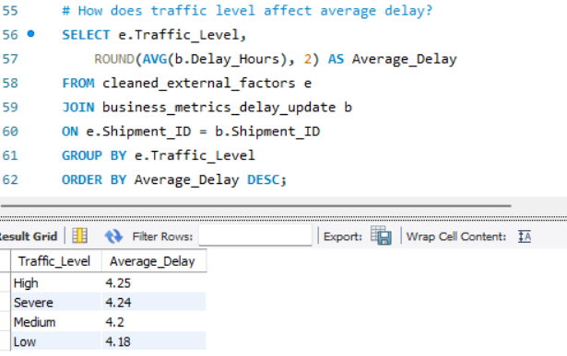
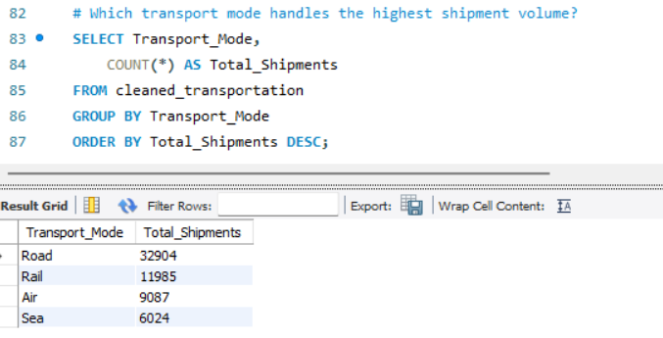
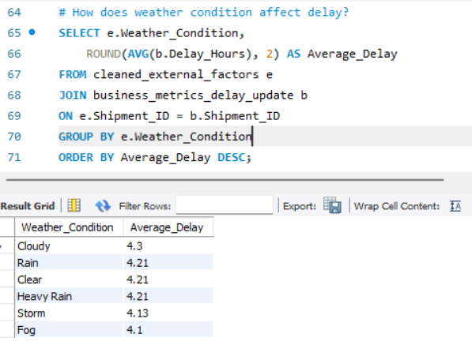
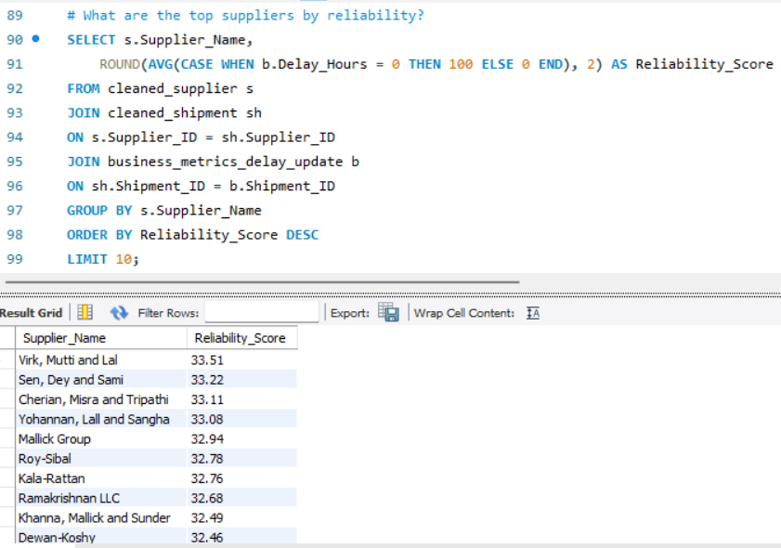
This SQL query identifies that traffic level how affects average delay shipments. There are 4 traffic level in dataset - High, Severe, Medium, Low.
This SQL query identifies that which transport mode handles the highest shipment volume. and transport mode Road handles the total 32904 shipments.
This SQL query identifies that how weather condition affect average delay and total 6 weather condition identifies in the dataset.
This SQL query identifies the reliability score and the top 10 ranges between 33.51 and 32.46.

Slide 16
Core KPIs and definitions
Total shipments
Delayed shipments
Delay rate
Distinct count of Shipment_ID
Distinct shipments where Delay Hours > 0
Delayed shipments ÷ total shipments
Volume
Service
Service
Average delay
Delivery cost
Supplier / warehouse count
Average Delay Hours
Sum or average, depending on question
Distinct entity IDs, Name
Severity
Cost
Capacity
16

Slide 17
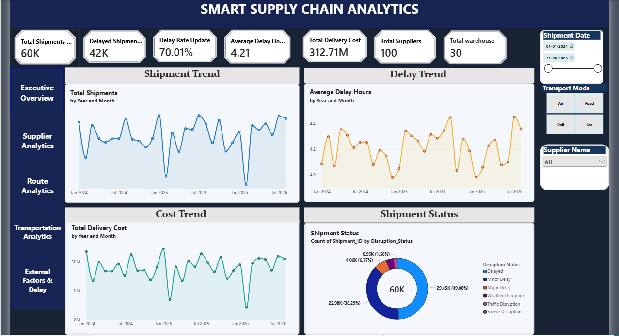
Power BI: executive overview
A management-facing summary with KPIs and trends.
SHIPMENTS
DELAY RATE
AVG DELAY
SUPPLIERS
60K
70%
4.21 h
100
10

Slide 18
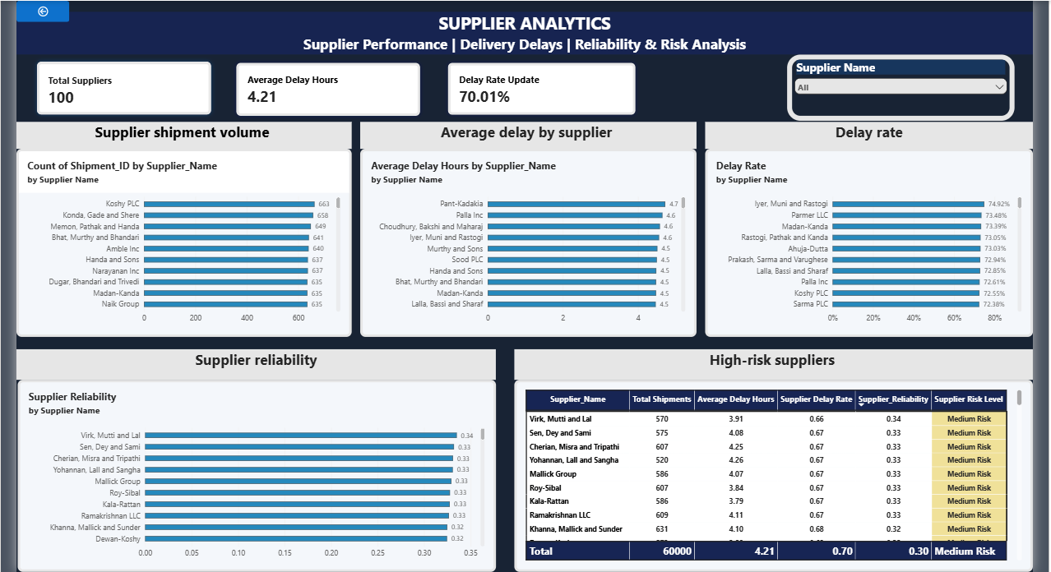
Supplier analytics
18

Slide 19
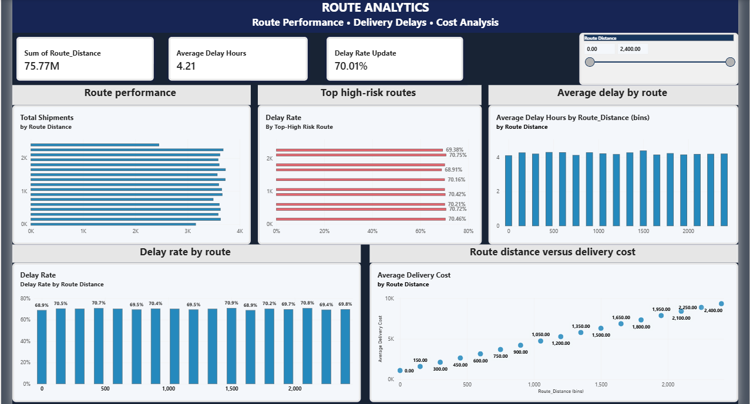
Route analytics
19

Slide 20
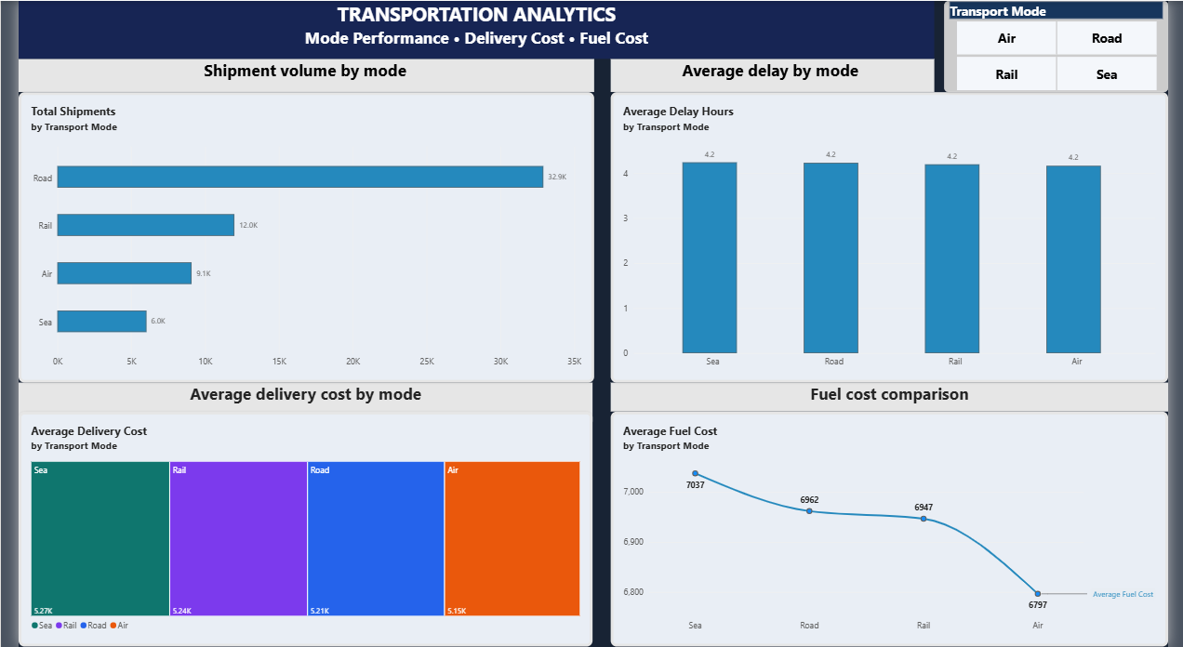
Transportation analytics
Compare transport modes on activity, delay and cost.
20

Slide 21
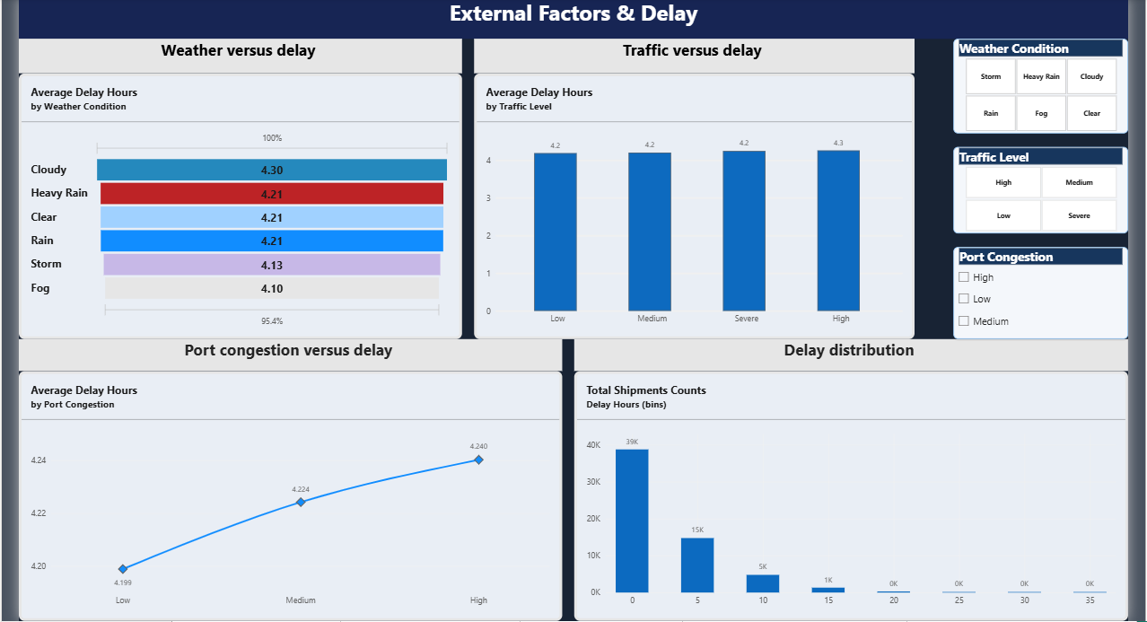
External factors and delay
21

Slide 22
KPI Analysis
KEY PERFORMANCE INDICATORS (KPIs)
KPIs are measurable values used to evaluate shipment performance, delivery delays, costs, and supply chain operations.
Total Shipments: Number of unique shipments analyzed.
Delayed Shipments: Number of shipments with delay hours greater than zero.
Delay Rate: Percentage of shipments that experienced delays(Delayed Shipments ÷ Total Shipments × 100)
Average Delay Hours: Average delay duration in hours.
Total Delivery Cost: Total cost of all analyzed deliveries.
Total Suppliers: Number of unique suppliers.
Total Warehouses: Number of unique warehouses.
22

Slide 23
Key Insights and Findings
Shipment Performance: Analyzed 60,000 shipment records to understand overall delivery performance.
Delivery Delays: Evaluated delay rates and average delay hours to assess shipment timeliness.
Supplier Performance: Compared supplier shipment volumes, average delays, and reliability.
Route Analysis: Examined route distances, delivery costs, and delay patterns to identify potential high-risk routes.
Transportation Analysis: Compared road, rail, air, and sea transportation based on shipment volume, delays, and costs.
External Factors: Analyzed how weather, traffic, port congestion, and holidays relate to shipment delays.
Dashboard Insights: Developed interactive Power BI dashboards to monitor KPIs and support data-driven decisions.
23

Slide 24
Business Recommendations
Reduce Delivery Delays: Monitor delayed shipments regularly and investigate the main causes of delays.
Improve Supplier Performance: Review supplier reliability and work with suppliers showing higher delay rates.
Optimize Transportation Routes: Evaluate high-risk routes and consider more efficient alternatives where possible.
Control Delivery Costs: Compare transportation and delivery costs to identify potential cost-saving opportunities.
Manage External Factors: Plan deliveries by considering weather, traffic, and port congestion conditions.
Monitor KPIs Regularly: Use the Power BI dashboard to track shipment volume, delay rate, average delay hours, and delivery costs.
Improve Data-Driven Decisions: Use updated shipment data to identify operational issues and support continuous improvement.
24

Slide 25
Conclusion
The Smart Supply Chain Analytics project demonstrates how Python, MySQL, and Power BI can be used to analyze 60,000 shipment records and gain meaningful business insights.
Data Analysis: Cleaned and Analyzed shipment data using Python.
Database Management: Stored and queried data using MySQL.
Performance Monitoring: Evaluated shipment delays, supplier performance, route efficiency, and delivery costs.
Interactive Visualization: Developed Power BI dashboards to monitor key performance indicators (KPIs).
Business Decision-Making: Identified areas for potential improvement in delivery performance and supply chain operations.
Overall, this project transforms raw shipment data into meaningful insights that can support better planning, cost management, and data-driven business decisions.
25

Slide 26
Future Scope
Real-Time Shipment Tracking: Integrate live shipment data to monitor delivery status.
Predictive Analytics: Use Machine Learning to predict shipment delays.
Route Optimization: Identify efficient routes to reduce delivery time and transportation costs.
Automated Alerts: Generate notifications for delayed or high-risk shipments.
Live Weather and Traffic Data: Integrate external data to improve delivery planning.
Streamlit Web Application: Develop an interactive web app for easy access to supply chain insights.
Automated Dashboard Updates: Schedule data refreshes to monitor updated KPIs and performance.
26

Slide 27
THANK YOU
Questions & discussion
MYSQL
POWER BI
Smart Supply Chain Analytics
27

